Slide 1
High-Performance Graphics 2024
26-28 July 2024
Denver, CO

Slide 2
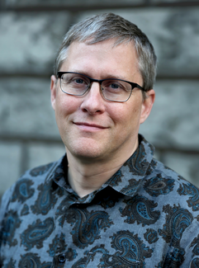
In Memoriam
Steven G. Parker

Slide 3
Steven Parker | Honorary Degree Recipient 2024
https://www.youtube.com/watch?v=3c89UXBIlY4

Slide 4
The heights by great men reached and kept
Were not attained by sudden flight,
But they, while their companions slept
Were toiling upward through the night.
- Henry Wadsworth Longfellow

Slide 6
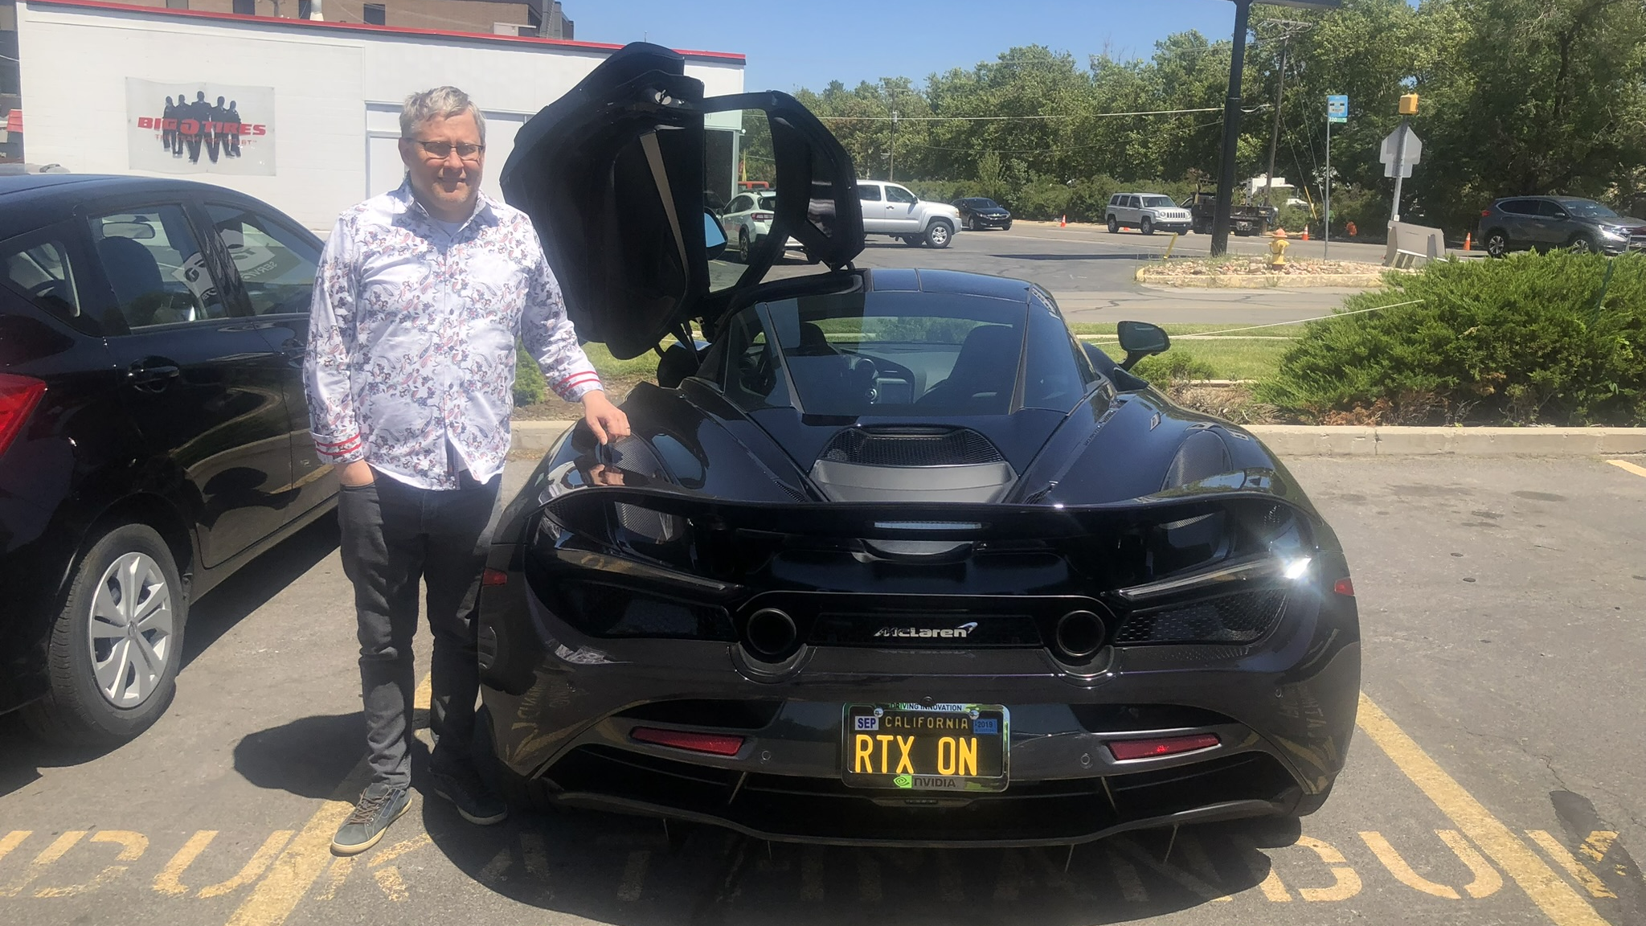

Slide 7
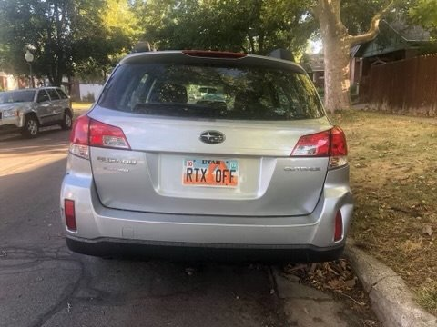

Slide 8
In celebration of his personal and professional legacy, his passion for and commitment to the High-Performance Graphics conference series, and his lasting contributions to the field of computer graphics, the HPG Steering Committee is honored to announce...

Slide 9
Steven G. Parker Test of Time Award

Slide 10
Citations – Google Scholar
103

Slide 11
Coarse Pixel Shading
K. Vaidyanathan, M. Salvi, R. Toth, T. Foley, T. Akenine-Möller, J. Nilsson, J. Munkberg, J. Hasselgren, M. Sugihara, P. Clarberg, T. Janczak, & A. Lefohn

Slide 12
Steven G. Parker Test of Time 2014 Award
2nd Place – 62 citations
Reduced Precision for Hardware Ray Tracing in GPUs
S. Keely
3rd Place – 35 citations
A Fast and Stable Feature-Aware Motion Blur Filter
J.-P. Guertin, M. McGuire, & D. Nowrouzezahrai

Slide 13
Wolfgang Straßer Best Paper Award

Slide 14
3rd Place

Slide 15
GPU-friendly Stroke Expansion
Raph Levien & Arman Uguray

Slide 16
2nd Place

Slide 17
H-PLOC: Hierarchical Parallel Locally-Ordered Clustering for Bounding Volume Hierarchy Construction
C. Benthin, D. Meister, J. Barczak, R. Mehalwal, J. Tsakok & A. Kensler

Slide 18
1st Place

Slide 19
Real-Time Procedural Generation with GPU Work Graphs
B. Kuth, M. Oberberger, C. Faber, D. Baumeister, M. Chajdas & Q. Meyer

Slide 20
Student Competition Award

Slide 21
Submission #4
https://www.shadertoy.com/view/XX3Gzr#

Slide 22
2nd Place

Slide 23
Wenjian Zhou University of Utah
https://www.shadertoy.com/view/lcXcD8

Slide 24
1st Place

Slide 25
Murilo Mesquita Carolina Universidade Federal de Goiás
https://www.shadertoy.com/view/XX3Gzr#

Slide 26
Chair’s Award

Slide 27
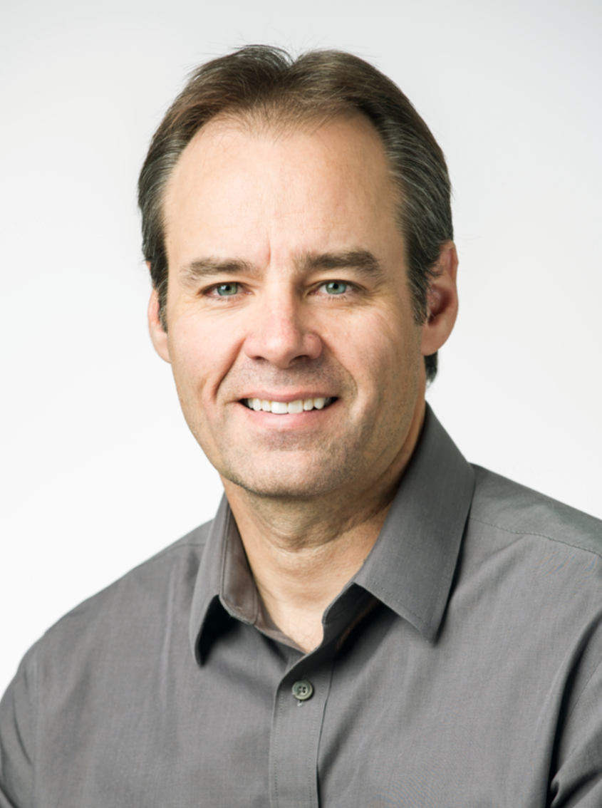
Kenny Gruchalla
Local Chair

Slide 28
HPG 2024 Committee
Program Chairs
Papers Chairs
Jacob Haydel, Univ. of Utah
Online Chair
Francois Demoullin, Apple
Registrars
Gaurav Bhokare, Univ. of Utah
Pengpei Hong, Univ. of Utah
Treasurers
Steve Molnar, NVIDIA (advisory)
Esteban Clua, Univ. Federal Fluminense
Richard Membarth, THI and DFKI
Jacco Bikker, Traverse Research
Aaron Knoll, AMD
Posters Chairs
Johannes Meng, Intel
Andrew Kensler, AMD
Sponsorship Chair
Kenny Gruchalla, NREL
Web Site Maintainers
Matthäus Chajdas, Intel
Joshua Steinhurst, Intel
Publicity Chair
Daqi Lin, NVIDIA
Student Competition Chairs
Anjul Patney, NVIDIA
Nicholas Vining, NVIDIA
Hot3D Chair
Won-Jong Lee, AMD
Local Chair
Andrew Garrard, Imagination Tech.

Slide 29
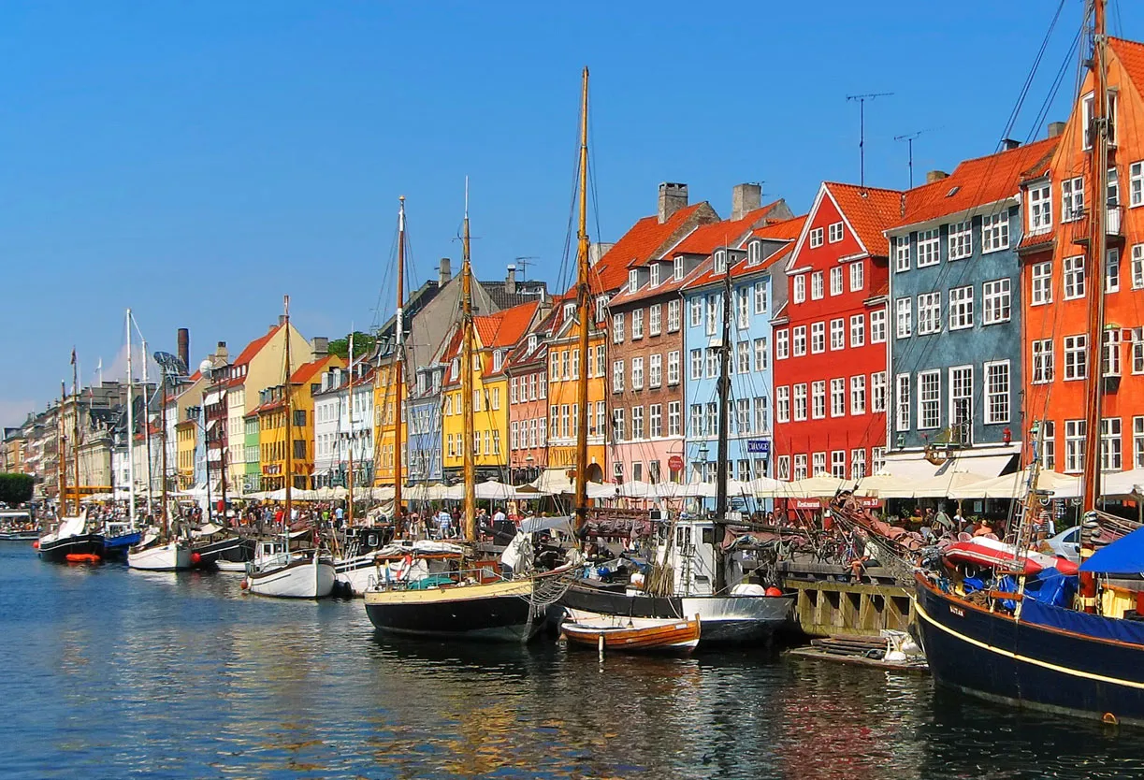
High-Performance Graphics 2025
Copenhagen, Denmark
Co-located with EGSR 2025
General Co-Chairs
Christiaan Gribble
???
Look for more information in the weeks ahead

Slide 30
Thank you!
See you in Copenhagen
High-Performance Graphics 2025

